Slide 1

Credit Risk Assessment Pipeline: End-to-End Data Engineering Project
Team Members:
Supriya Anumandla
Santhi Mondru
Saikam Venkata Samba Siva Rao
Madhu Syed

Slide 2
Project Overview & Objectives
Built a scalable cloud-based ETL pipeline for credit risk assessment
Implemented Medallion Architecture (Bronze → Silver → Gold)
Performed data cleaning and transformations using PySpark
Generated key credit risk metrics for borrower analysis
Enabled scalable analytics and reporting through dashboards

Slide 3
Problem Statement
Managing large volumes of loan data from multiple sources.
Handling data quality issues such as missing, duplicate, and inconsistent data.
Integrating diverse datasets into a unified data pipeline.
Difficulty in identifying high-risk borrowers due to unstructured and scattered data.

Slide 4
Technology Stack
Amazon S3 (Data Lake Storage )
AWS Glue (ETL Service)
Databricks (Unified Analytics Platform)
PySpark (Distributed Processing)
Delta Lake (Data Lakehouse)
Apache Airflow (Workflow Orchestration)

Slide 5
Design Solutions for building Pipelines
High Level Design
Low-Level Design

Slide 6
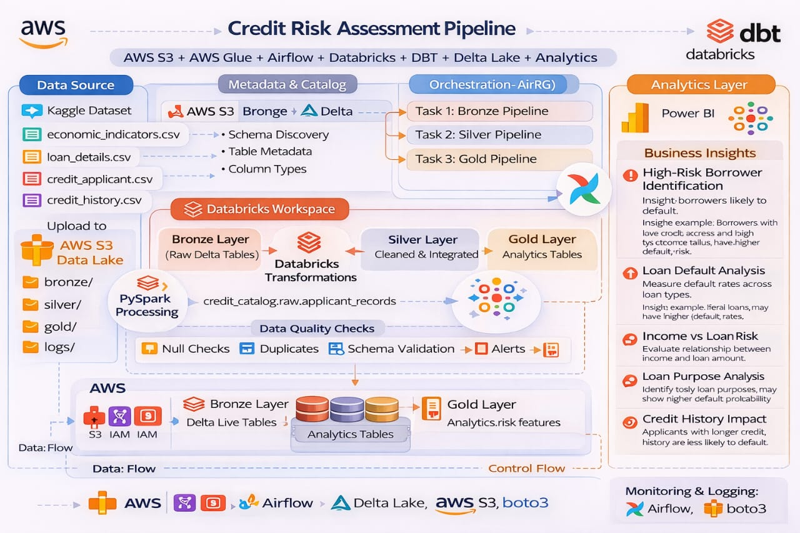
Lakehouse Architecture (High - Level Design)

Slide 7
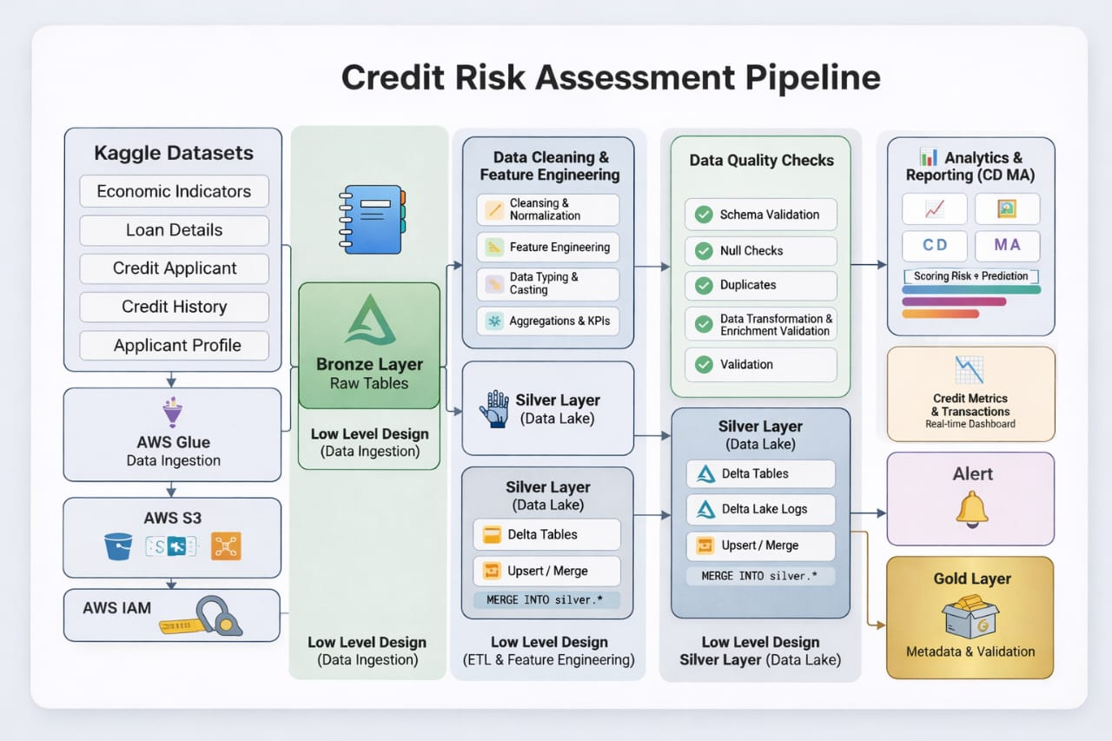
Low-Level Design

Slide 8
Data Quality & Error Handling
Performed schema validation to ensure correct data types and structure
Applied null checks and data completeness monitoring
Implemented duplicate detection and removal
Enabled error handling, logging, and alerting mechanisms
Maintained error tables and audit logs for tracking failed records
Used data validation during transformations to ensure reliable outputs

Slide 9
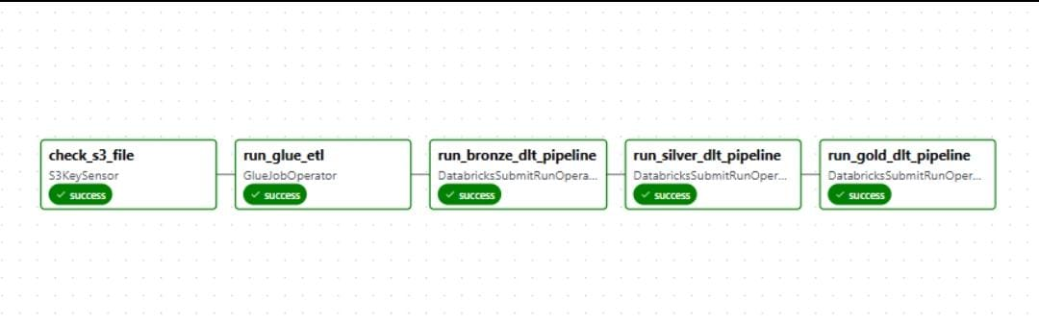
Pipeline Orchestration(Airflow DAG)
Designed DAG “s3_glue_databricks_pipeline” using Apache Airflow (MWAA)
Executed AWS Glue ETL job for data preprocessing (CSV → Parquet)
Triggered Databricks Bronze, Silver (DLT), and Gold pipelines sequentially
Managed task dependencies and workflow execution order
Implemented failure handling, retries, and monitoring using logs

Slide 10
Alerts & Monitoring (Slack Integration)
Created Slack Workspace & Channel
Generated Webhook URL in Slack
Configured Slack in Databricks (Notifications)
Enabled Alerts in Databricks Jobs / Pipelines
Triggered Real-time Notifications in Slack
Monitored Pipeline Status & Failures

Slide 11
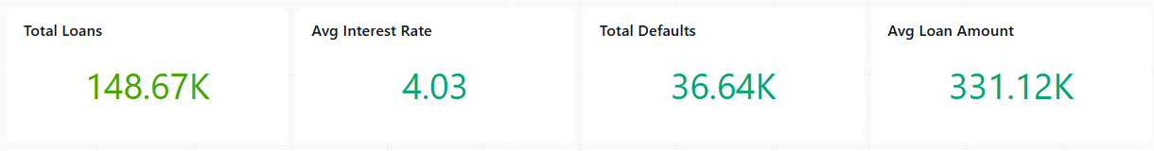
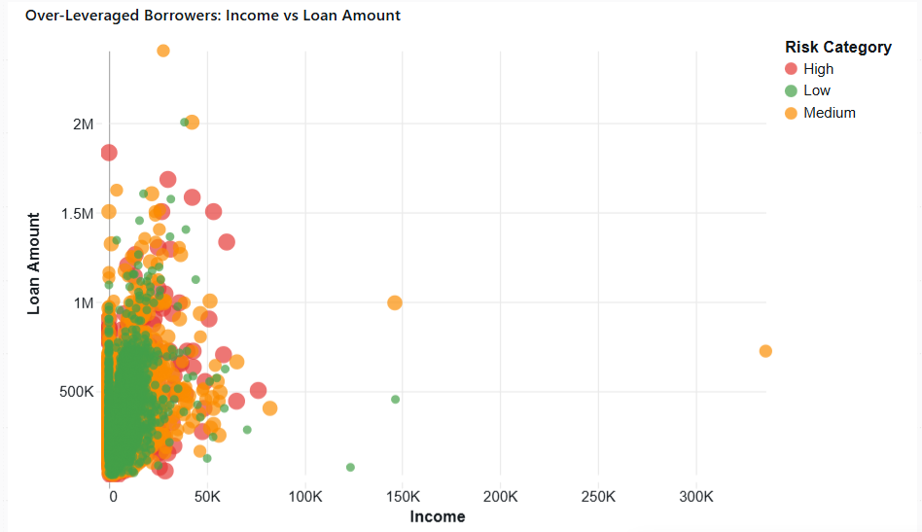
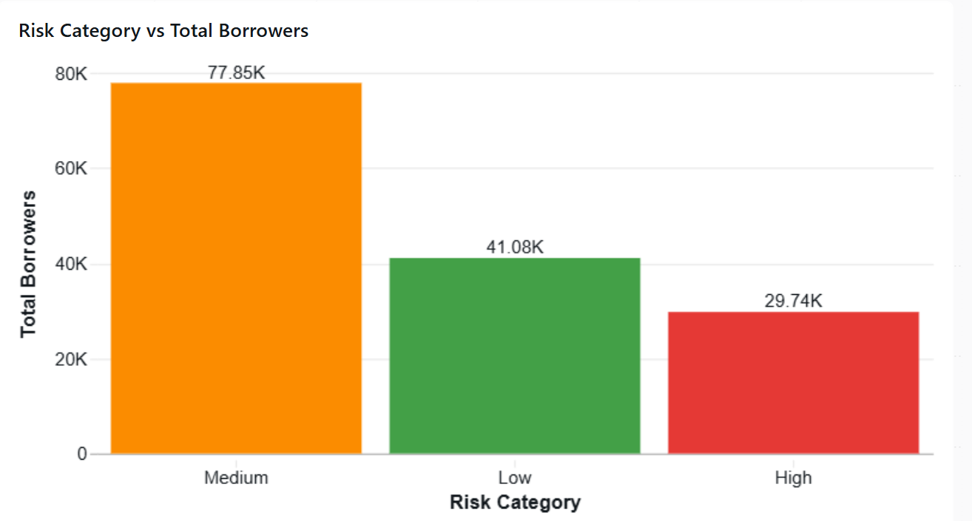
Dashboards

Slide 12
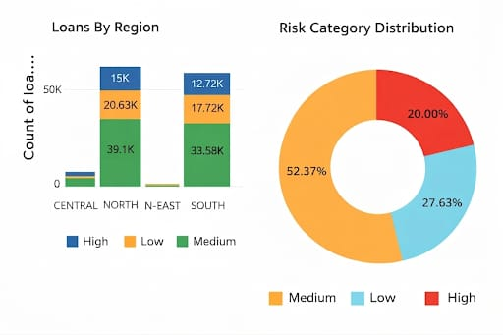

Slide 13
Business Insights & Outcomes
Enabled accurate identification of high-risk borrowers by:
> Identified high-risk borrowers using credit score, LTV, and debt- to-income ratio
> Categorized borrowers into High, Medium, and Low risk using derived risk scoring logic
Improved data-driven decision making for loan approvals
Reduced data inconsistencies through structured data processing
Provided actionable insights using dashboards and analytics
Enhanced scalability and performance of the data pipeline

Slide 14
THANK YOU!

